Slide 1
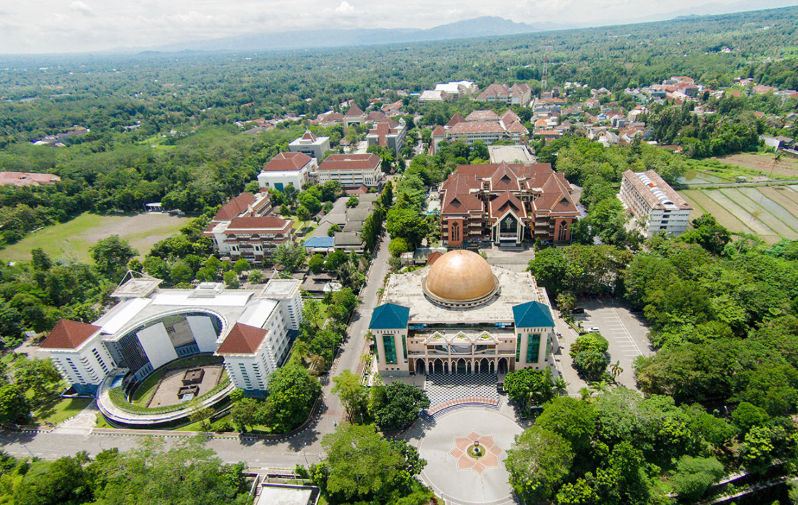
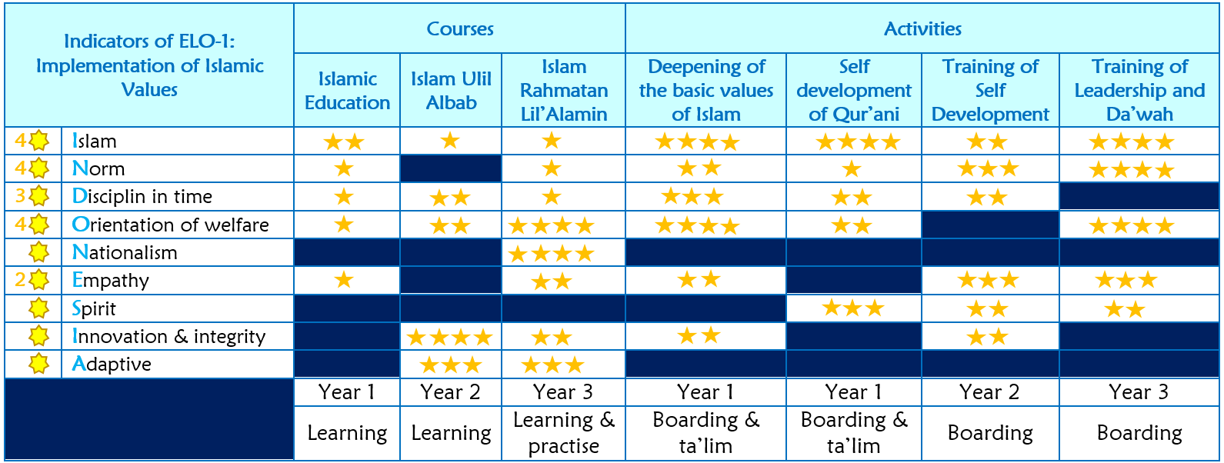
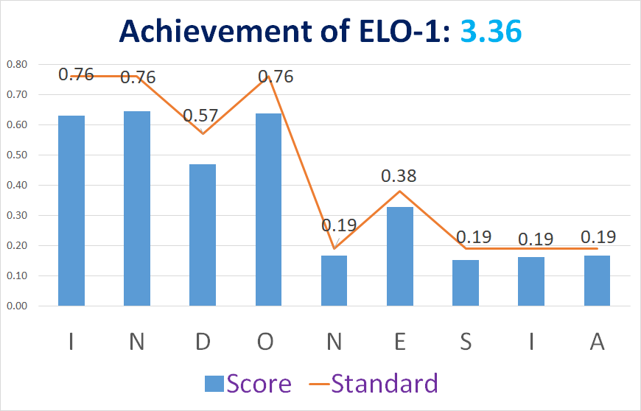
EXPECTED LEARNING OUTCOME OF ISLAMIC VALUES
Kariyam
(Head of UII QA Board)
AUN-QA Criteria 1: ELO
Expected Learning Outcome
Universitas Islam Indonesia (UII) is the meeting of religion with science in good cooperation to help improving the welfare of the community
Main Campus of UII
Parts of ELO
ELO-1: Implementation of Islamic Value
ELO-2: Competency in Science Discipline
Library building: symbol of science
Mosque building: symbol of religion
Assessment of implementation Islamic values conducted based on some indicators. The keywords of indicators are a core values of Islam, norm, discipline in time, orientation of welfare, nationalism, empathy, spirit, integrity and innovation, and adaptive. The rubric of assessment for ELO-1 as table 1. All of students must be understand that they study at UII only to get the Mercy of God. Academic staff and support staff must understood too, that they work only because hoped Mercy of God.
Table 1. Assessment Rubric for ELO-1
On the other parts, to achievement all of the UII’s goal includes all of ELO, UII have standard of quality assurance at ten principle areas, that are Management (M), Education (E), Research (R), Community service (C), Yield of services (Y), Output (O), Facilities (F), Governance (G), Outcome and cooperation (O), and Da’wah Islamiah (D). Acronym of Standard UII is “MERCY OF GOD”, and periodically UII conducted a monitoring and internal quality audit on the implementation of this standard. The example of monitoring of Standard UII, especially for education in chapter ELO-1 of a graduate as figure 1.
Figure 1. Example Achievement of ELO-1

